Slide 1


Popularity Prediction of Facebook Videos for Higher Quality Streaming
∗
Linpeng Tang
Qi Huang , Amit Puntambekar
Ymir Vigfusson , Wyatt Lloyd , Kai Li
♭
♭
♭
∗
†
‡
∗
†
‡
♭

Slide 2
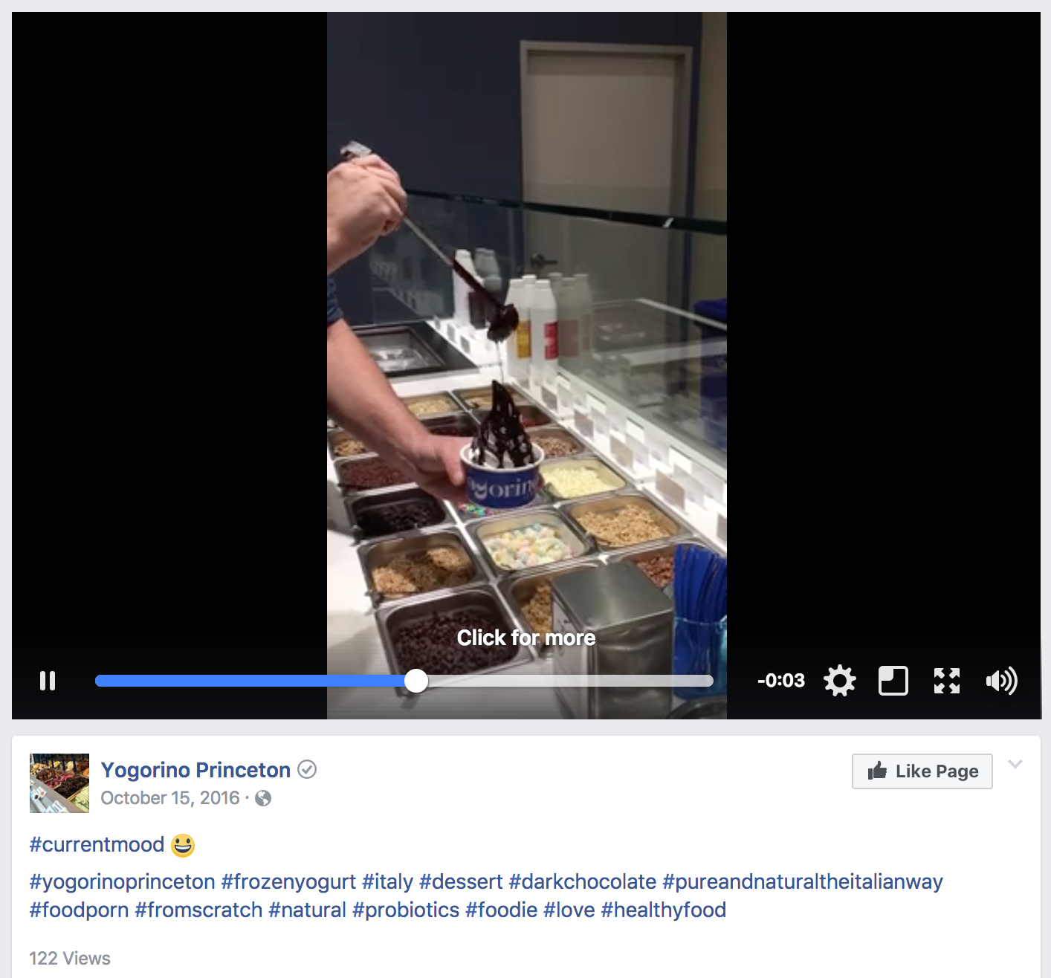
Videos are Central to Facebook 8 billion views per day
9-year old singing on America’s Got Talent
44M views
Black bear roaming in Princeton
3.8K views
Small shop making frozen yogurt
122 views

Slide 3
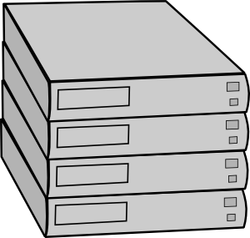

Workflow of Videos on Facebook
Streaming Video Engine
Original
Encoded
Backend Storage
Upload
CDN
ABR streams the best quality version of the video that fits!
Intensive processing needed to create multiple video versions for ABR streaming
ABR Streaming

Slide 4
Better Video Streaming from More Processing
Better compression at the same quality
QuickFire: 20% size reduction using 20X computation
More users can view the high quality versions
Bob
Alice

Slide 5
Better Video Streaming from More Processing
Better compression at the same quality
QuickFire: 20% size reduction using 20X computation
More users can view the high quality versions
Better Compression
Bob
Alice

Slide 6
How to apply QuickFire for FB videos
Infeasible to encode all videos with QuickFire
Increase by 20X the already large processing fleet
High skew in popularity
Reap most benefit with modest processing?

Slide 7
Opportunity: High Skew in Popularity
Access logs of 1 million videos randomly sampled by ID
Watch time: total time users spent watching a video

Slide 8
Opportunity: High Skew in Popularity
We can serve most watch time even with a small fraction of videos encoded with QuickFire
Can we predict these videos for more processing?
80%+ watch time

Slide 9
CHESS Video Prediction System
Popularity prediction is important for higher quality streaming
Direct encoding on videos with the largest benefit
Goal of CHESS video prediction system
Identify videos with highest future watch time
Maximize watch-time ratio with budgeted processing

Slide 10
CHESS Video Prediction System
Streaming Video Engine
Predicted Popular Videos
Backend Storage
CHESS-VPS
CDN
Access logs
Social signals
Facebook Graph Serving System

Slide 11
CHESS Video Prediction System
Streaming Video Engine
Predicted Popular Videos
Original
QuickFire Encoded
Backend Storage
CHESS-VPS
CDN
Access logs
Social signals
Facebook Graph Serving System

Slide 12
CHESS Video Prediction System
Streaming Video Engine
Predicted Popular Videos
Original
QuickFire Encoded
Backend Storage
CHESS-VPS
CDN
Access logs
Social signals
Facebook Graph Serving System
Serving QuickFire-encoded versions!

Slide 13
Requirements of CHESS-VPS
Handle working set of ~80 million videos
Generate new predictions every few minutes
Requires a new prediction algorithm: CHESS!

Slide 14
CHESS Key Insights
Efficiently model influence of past accesses as the basis for scalable prediction
Combine multiple predictors to boost accuracy

Slide 15
Efficiently model past access influence
Self exciting process
A past access makes future accesses more probable, i.e. provides some influence on future popularity
Influence of past accesses

Slide 16
Efficiently model past access influence
Self exciting process
A past access makes future accesses more probable, i.e. provides some influence on future popularity
Prediction: sum up total future influence of all past accesses
now
Total future influence

Slide 17
Efficiently model past access influence
Influence modeled with kernel function
Power-law kernel used by prior works
Provides high accuracy
Scan all past accesses, O(N) time/space not scalable

Slide 18
Efficiently model past access influence
Influence modeled with kernel function
Power-law kernel used by prior works
Key insight: use exponential kernel for scalability

Slide 19
Efficiently model past access influence
Self exciting process with the exponential kernel
Current Access Watch-time
Exponential
Decay
Previous Prediction
+
x

Slide 20
Efficiently model past access influence
Single exponential kernel is less accurate than power-law kernel
10% lower watch time ratio
O(1) space/time to maintain
Single exponential kernel is
less accurate yet scalable

Slide 21
Combining Efficient Features in a Model
Key insight: maintain multiple exponential kernels
O(1) space/time
Exponential kernels
Actual access pattern
Modeled by
Combining multiple exponential kernels is as accurate as a power-law kernel

Slide 22


Combining Efficient Features in a Model
Raw features
Past access watch-time
Multiple Kernels
Neural Network
likes
Future Popularity
comments
shares
owner likes
Directly-used Features
video age
Social signals further boosts accuracy

Slide 23
CHESS Video Prediction System
Prediction workers
Aggregated top videos
Access logs
NN Models
Streaming
Shard₁
Worker₁
Aggr
Client
Model
Shard₂
Worker₂
Shard₃
Worker₃
Aggr
Client
Model
Shard₄
Worker₄

Slide 24
Evaluation
What is the accuracy of CHESS?
How do our design decisions on CHESS affect its accuracy and resource consumption?
What is CHESS’s impact on video processing and watch time ratio of QuickFire?

Slide 25
Evaluation
What is the accuracy of CHESS?
How do our design decisions on CHESS affect its accuracy and resource consumption?
What is CHESS’s impact on video processing and watch time ratio of QuickFire?

Slide 26
Metrics
Watch time ratio
Ratio of watch time from better encoded videos
Directly proportional to benefits of better encoding
Processing time

Slide 27
Metrics
Watch time ratio
Ratio of watch time from better encoded videos
Directly proportional to benefits of better encoding
Processing time (infeasible to encode all videos)
Video length processing time
Video length ratio ≈ computation overhead

Slide 28
CHESS is Accurate
Vary video length ratio (proxy for processing overhead)
Observe watch time ratio of better encoded videos

Slide 29
CHESS is Accurate
Initial(1d): initial watch time up to 1 day after upload

Slide 30
CHESS is Accurate
Initial(1d): initial watch time up to 1 day after upload
SESIMIC: handcrafted power-law kernel

Slide 31
CHESS is Accurate
Initial(1d): initial watch time up to 1 day after upload
SESIMIC: handcrafted power-law kernel
CHESS provides higher accuracy than even the non-scalable state of the art

Slide 32
CHESS Reduces Encoding Processing
Predict on whole Facebook video workload in real-time
Sample 0.5% videos for actual encoding
CHESS reduces CPU by 3x (54% to 17%)
for 80% watch time ratio

Slide 33
Related Work
Popularity Prediction
Hawkes'71, Crane'08, Szabo'10, Cheng'14, SEISMIC'15
CHESS is scalable and accurate
Video QoE Optimization
Liu'12, Aaron'15, Huang'15, Jiang'16, QuickFire'16
Optimize encoding with access feedback
Caching
LFU‘93, LRU’94, SLRU‘94, GDS’97, GDSF‘98, MQ’01
Identify hot items to improve efficiency

Slide 34
Conclusion
Popularity prediction can direct encoding for higher quality streaming
CHESS: first scalable and accurate popularity predictor
Model influence of past accesses with O(1) time/space
Combine multiple kernels & social signals to boost accuracy
Evaluation on Facebook video workload
More accurate than non-scalable state of the art method
Serve 80% user watch time with 3x reduction in processing

